Slide 1


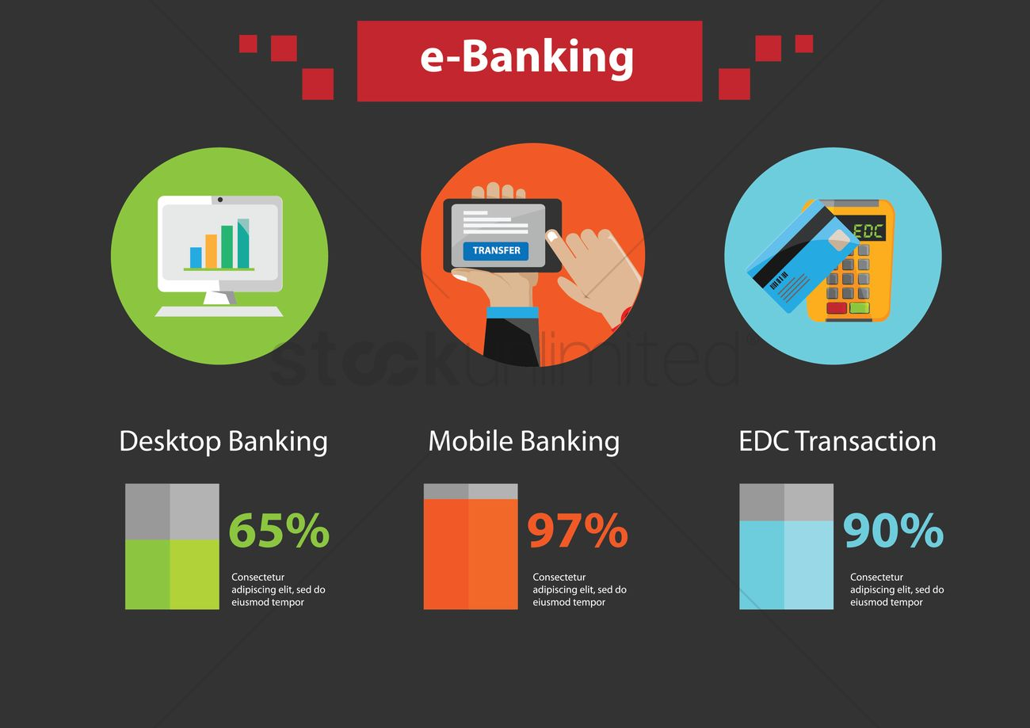
E-BANKING
D Rajashree
B.E-Cse(2nd year)

Slide 2

AIM:
TO VERIFY AND VALIDATION THE E-BANKING

Slide 3
REQUIREMENTS:
USER ID AND PASSWORD
BANK ACCOUNT
E BANK
NETWORK FACILITIES
BENEFICIARY ACCOUNT
FUND TRANSFER

Slide 4
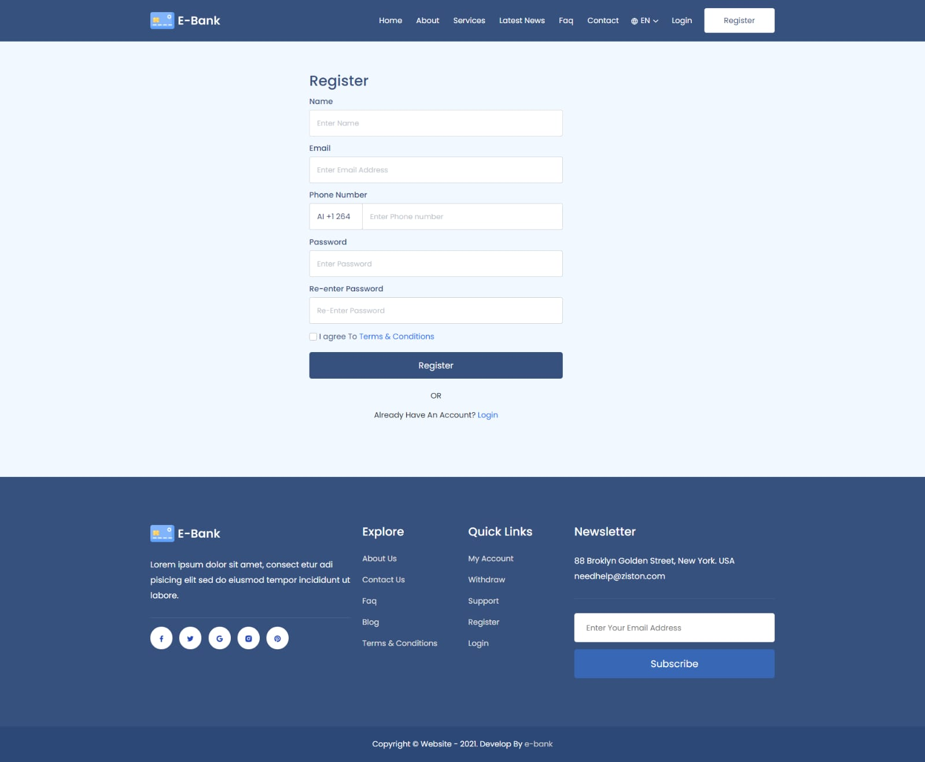
LOGIN PAGE

Slide 5
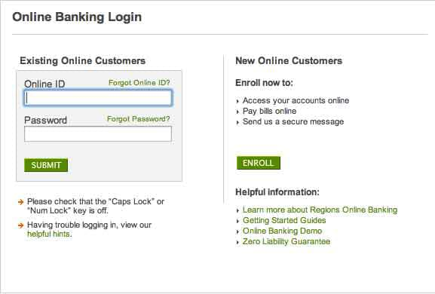
SEARCHING PAGE

Slide 6
TEST CASE SCENARIO:
CAN THE USER LOGIN WITH A VALID EMAIL ID AND PASSWORD?
TO VERIFY THE MTPIN IS VALID OR NOT ?
CAN THE USER CHECK BALANCE OF OUR BANK ACCOUNT OR NOT?
TO CHECK THE USER GO CORRECT FOR BANK TO BANK TRANSFER OR NOT
CAN THE USER ENTERED A ACCOUNT NUMBER FOR TRANSFER?
CAN USER ENTERED THE MAXIMUM AMOUNT OF TRANSFER?
CAN THE USER ADD THE BENEFICIARY ACCOUNT?
CAN THE USER ENTERED WITH A UPI IP ?
TO VERIFY THE USER FINISH THE FINAL PROCESS FOR FUND TRANSFER
CAN THE USER CHECK THE BANK BALANCE IN E-BANKING?

Slide 7
POSITIVE SCENARIO:
CAN THE USER ENTERED A VALID USER ID AND PASSWORD?
TO VERIFY THE MTPIN IS VALID?
CAN THE USER CHECKS A BANK BALANCE?
CAN THE USER ENTERED CORRECT OPTION FOR FUND TRANSFER?
TO VERIFY THE USER ENTERED VALID ACCOUNT NUMBER?
CAN THER USER SELECTED THE VALID MAXIMUM AMOUNT TRANSFER?
CAN THE USER ADD VALID BENEFICIARY ACCOUNT?
TO VERIFY THE FINAL PROCESS WAS VALID?
CAN THE USER ENTERED VALID UPI ID?
TO CHECK THE BANK BALANCE WITH VALID ACCOUNT

Slide 8
NEGATIVE SCENARIO:
WHAT HAPPENED WHEN THE USER ENTERED INVALID ID AND PASS?
FORGOT PASSWORD,IS THE OPTION WORKING ?
WHAT HAPPEN WHEN USER ENTERED VALID ID AND INVALID PASS?
CAN USER ENTERED THE INVALID MTPIN?
TO VERIFY USER ENTERS THE WRONG OPTION FOR TRANSFER?
CAN USER ENTERED INVALID MAXIMUM AMOUNT?
CAN THE USER ENTERED INVALID BENEFICIARY ACCOUNT?
WHAT HAPPEN WHEN THE USER ENTERED INVALID UPI ID?
WHAT HAPPENED WHEN THE NETWORK FALLS DOWN?
CAN THE USER CHECK INVALID BANK BALANCE.

Slide 9
TEST CASE:
CAN THE USER ENTERED VALID USER ID AND PASS = POSITIVE
WHAT HAPPENED WHEN THE USER ENTERED INVALID MTPIN = NEGATIVE
CAN THE USER ENTERED VALID BENEFICIARY ACCOUNT = POSITIVE
WHAT HAPPENED WHEN THE USER ENTERED INVALID UPI PIN = NEGATIVE
CAN THE USER ENTERED A VALID AMOUNT TO TRANSFER = POSITIVE
CAN THE USER ENTERED ON VALID BANK TRANSFER OPTION = POSITIVE
WHAT HAPPENED WHEN USER ENTERED INVALID AMOUNT = NEGATIVE
TO VERIFY THE VALID MAXIMUM AMOUNT = POSITIVE
WHAT HAPPEN THE USER HAVE INVALID MINIMUM BALANCE = NEGATIVE

Slide 10
THANK YOU
.

